Slide 1
Web and mobile app development – csc3054/7054
3.2 In-class exercises

Slide 2
“Ultimate sports quiz” application
Include questions that are less common or repetitive than the standard sports quiz app.
Difficulty options available.
Counter during the quiz.
Images used to support the questions.
Interesting questions.
Different sports.

Slide 3
“Ultimate sports quiz” application

Slide 4
What we discussed in the last lecture?
Widget basics
Intents/pendingintents
Started creating widget layout

Slide 5
Content outline
Exercises
Summary
Next lecture
Further readings

Slide 6
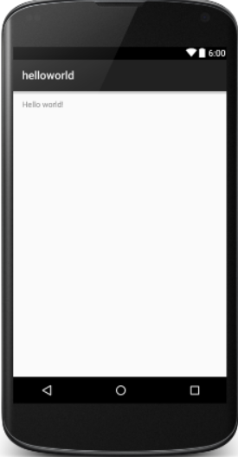
Exercise 1 – making the text invisible
Task: To remove “Hello World!” from the display
Tips: we can work with “activity_main.xml” or “MainActivity.java”

Slide 7
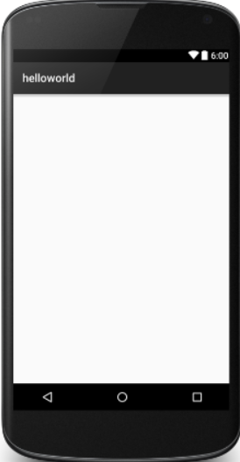
Expected Outcome

Slide 8
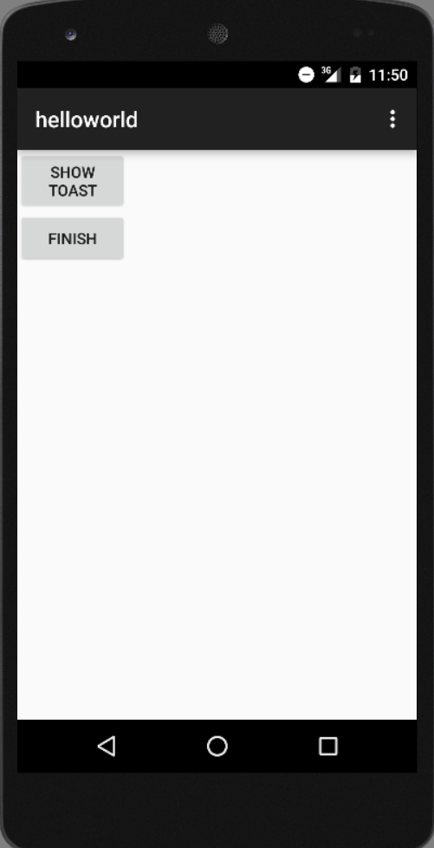
Exercise 2 – multiple buttons’ display
To complete the code in order to show correct texts on the two buttons. See the right hand side.

Slide 9
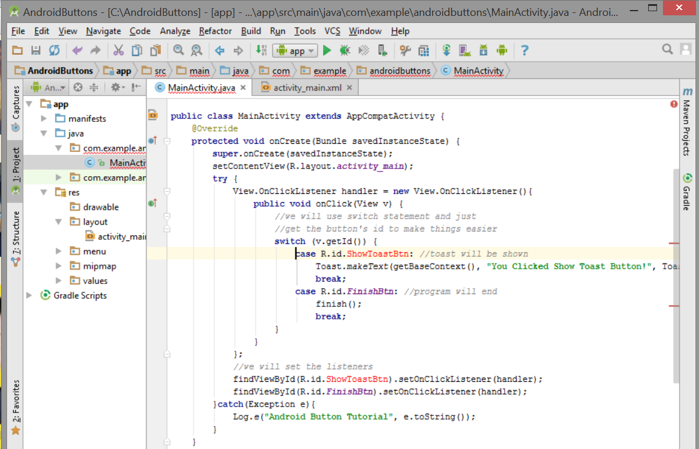
Exercise 2 – multiple buttons’ display
We have errors in the code – see below

Slide 10
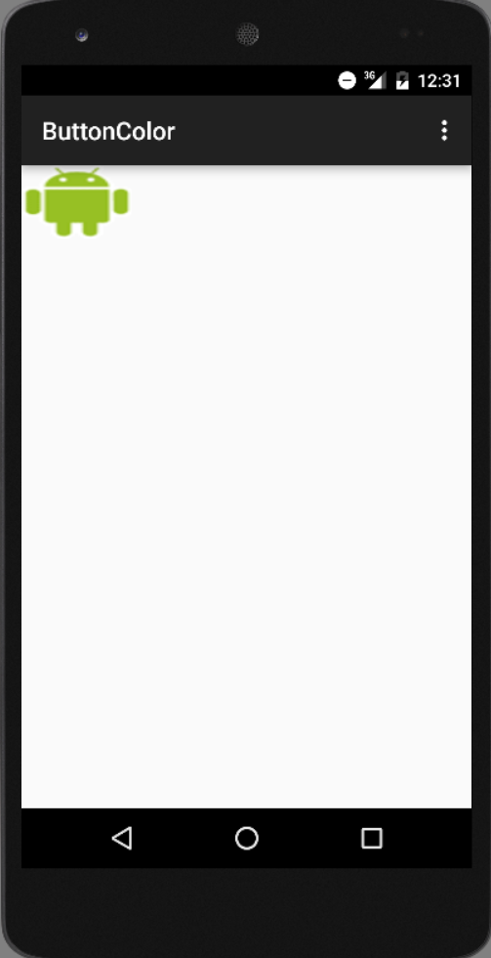
Exercise 3 – change the color of button
Before the button is tapped

Slide 11
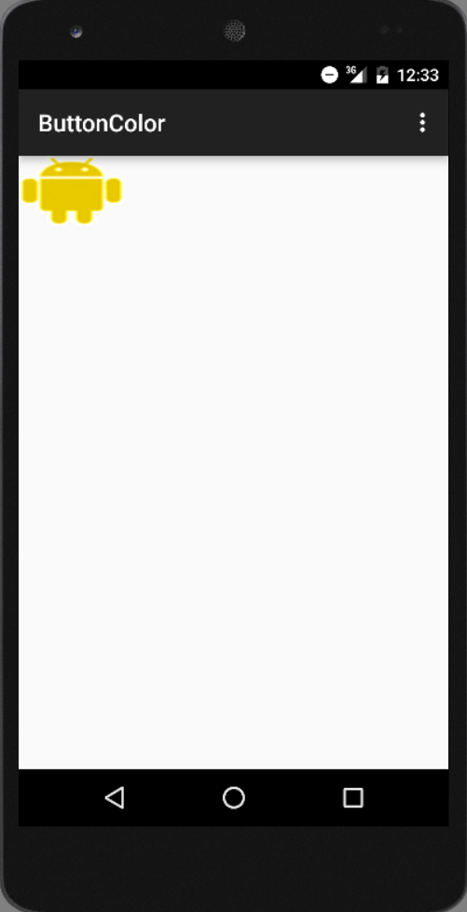
Exercise 3 – change the color of button
After the button is tapped

Slide 12
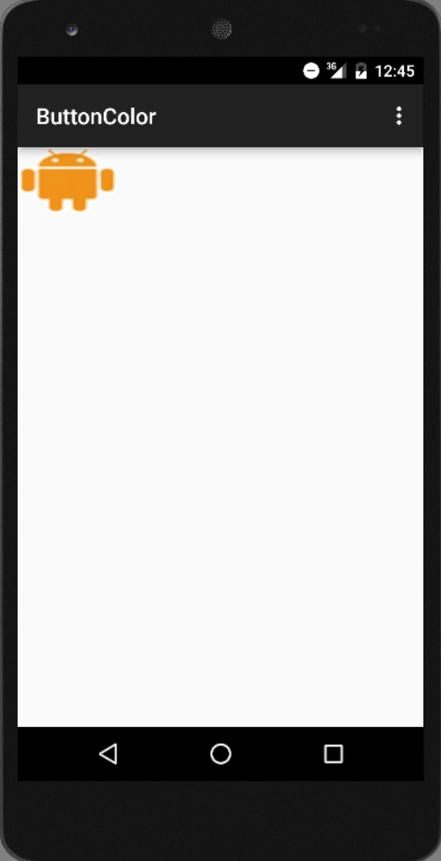
Use keyboard attached to the system
Button is clicked
Button is highlighted

Slide 13
Content outline
Exercises
Summary
Next lecture
Further readings

Slide 14
Summary
Invisible texts.
Multiple buttons to show.
Button color change.

Slide 15
Content outline
Exercises
Summary
Next lecture
Further readings

Slide 16
next lecture
To continue introducing the home-screen widget.

Slide 17
Content outline
Exercises
Summary
Next lecture
Further readings

Slide 18
Further readings
http://developer.android.com/training/index.html
Android Application Development for Dummies, Donn Felker, Wiley Publishing, Inc., NJ, 2011.

